Slide 1
State of the Pandemic
Dr. Walensky

Slide 2
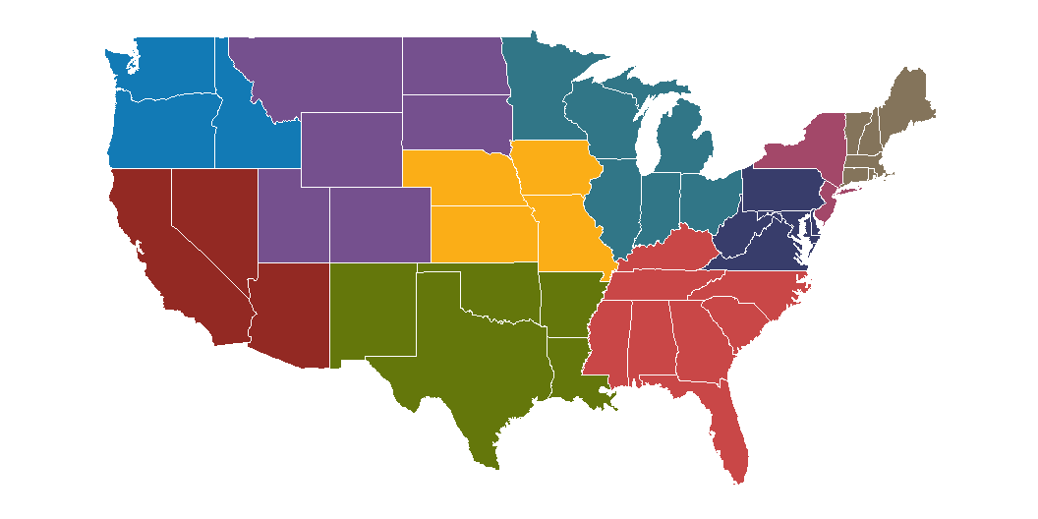

Slide 3


Slide 4
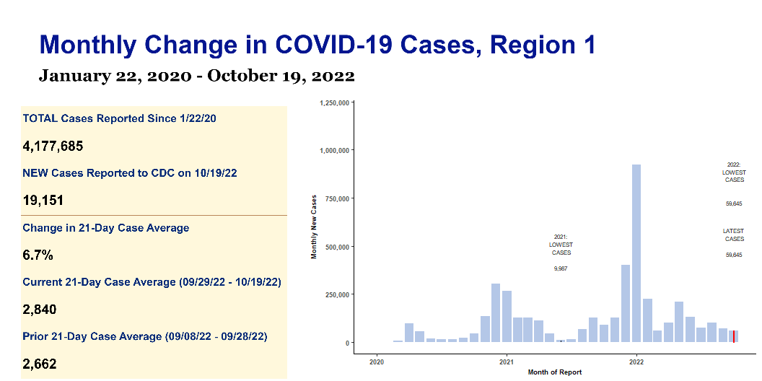

Slide 5
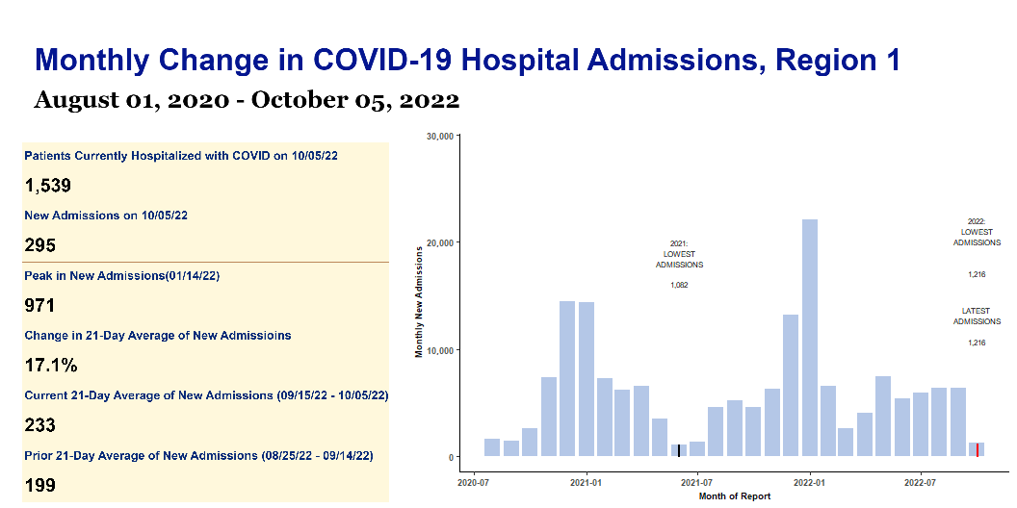

Slide 6
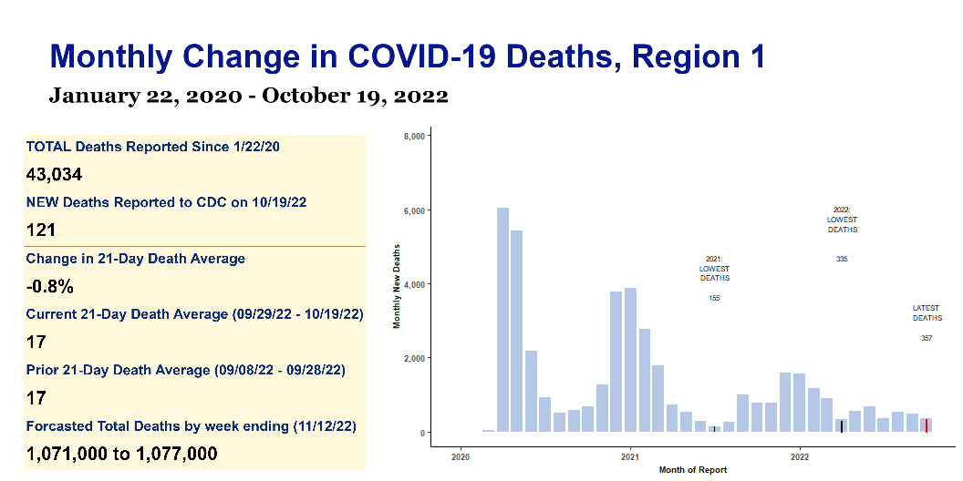

Slide 7
Region 1 Monthly COVID Report | Region 1 Monthly COVID Report | Region 1 Monthly COVID Report | Region 1 Monthly COVID Report | Region 1 Monthly COVID Report
s | s | s | s | s
Key Metrics | Key Metrics | Key Metrics | Key Metrics | Key Metrics
indicator | Total to date | Most recent week | Daily average | Period-on-period change
Cases | 4,177,685 | 19,151 | 2,840 | 6.7%
Hospital Admissions | 169,686 | 1,744 | 249 | 6.9%
Deaths | 43,034 | 121 | 17 | -0.8%
Test Positivity | 5.1% | N/A | 8.5% | -3.9%

